Slide 3
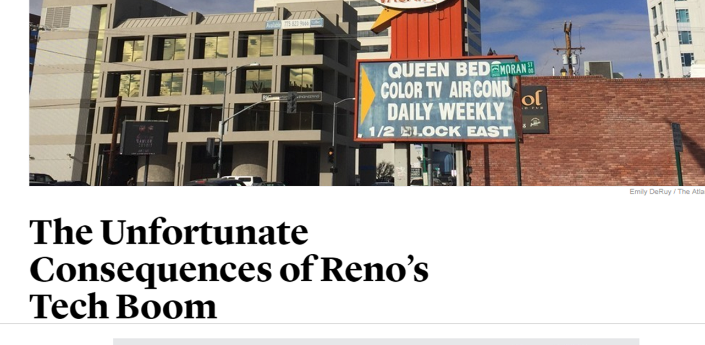

Slide 5
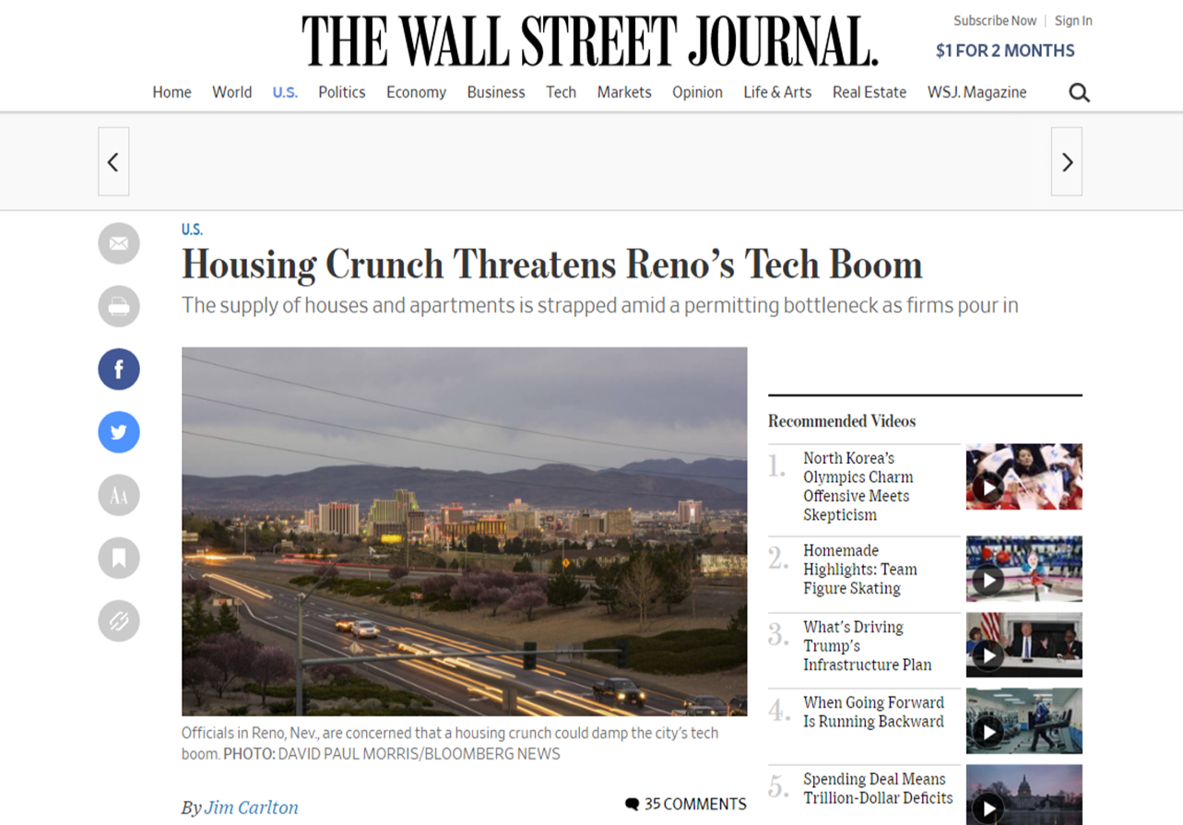

Slide 6
Here to Help
Reno Housing Authority

Slide 7
History of Service
Housing Act of 1937
Created in 1943
Serves Reno, Sparks, Washoe County

Slide 8
Serving 4,000 Households

Slide 9
Serving 4,000 Households

Slide 10
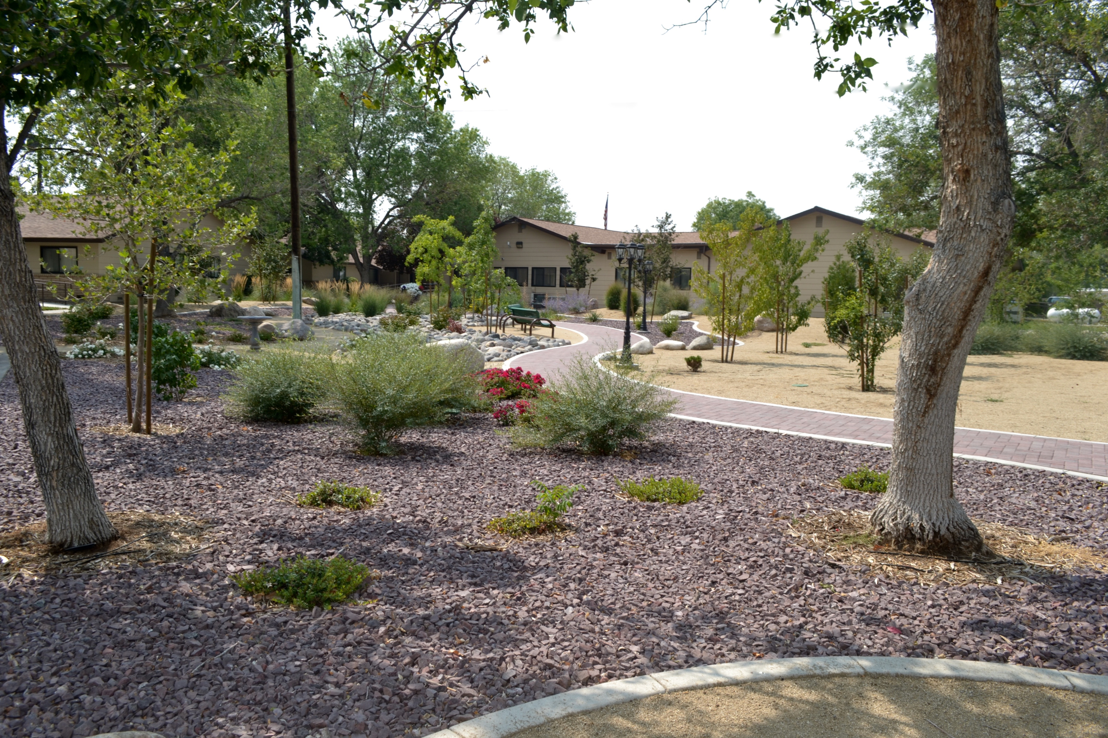
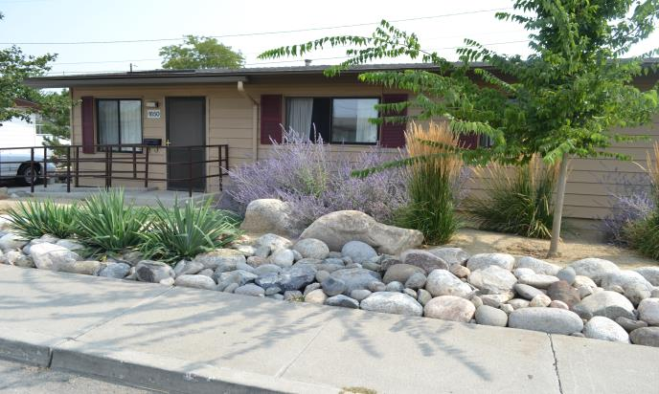
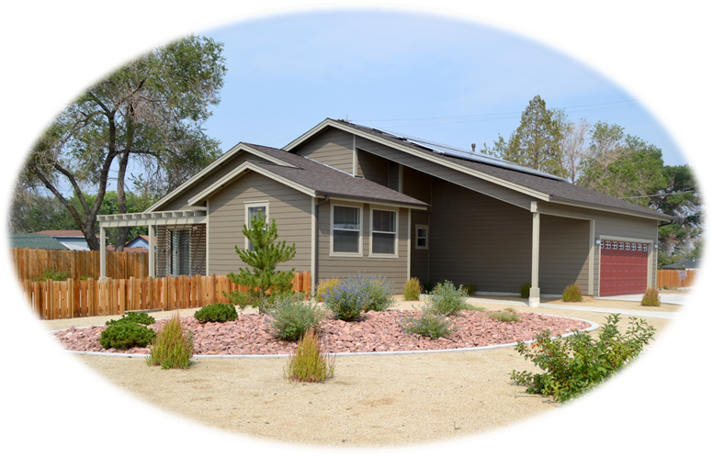
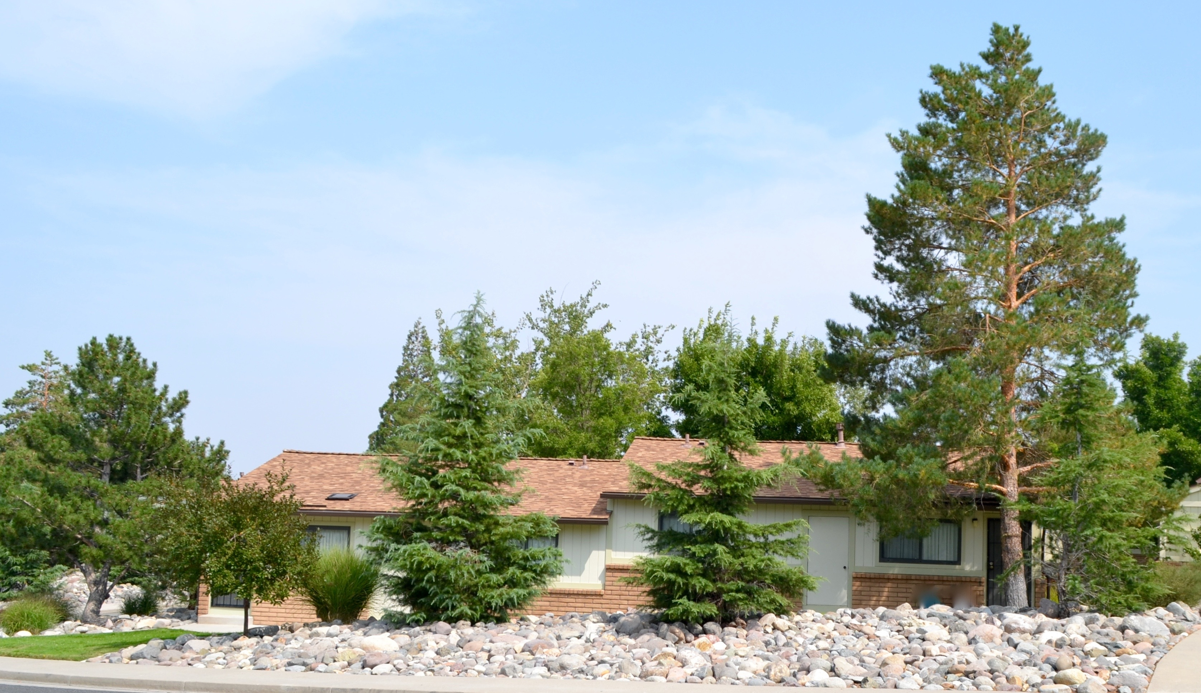
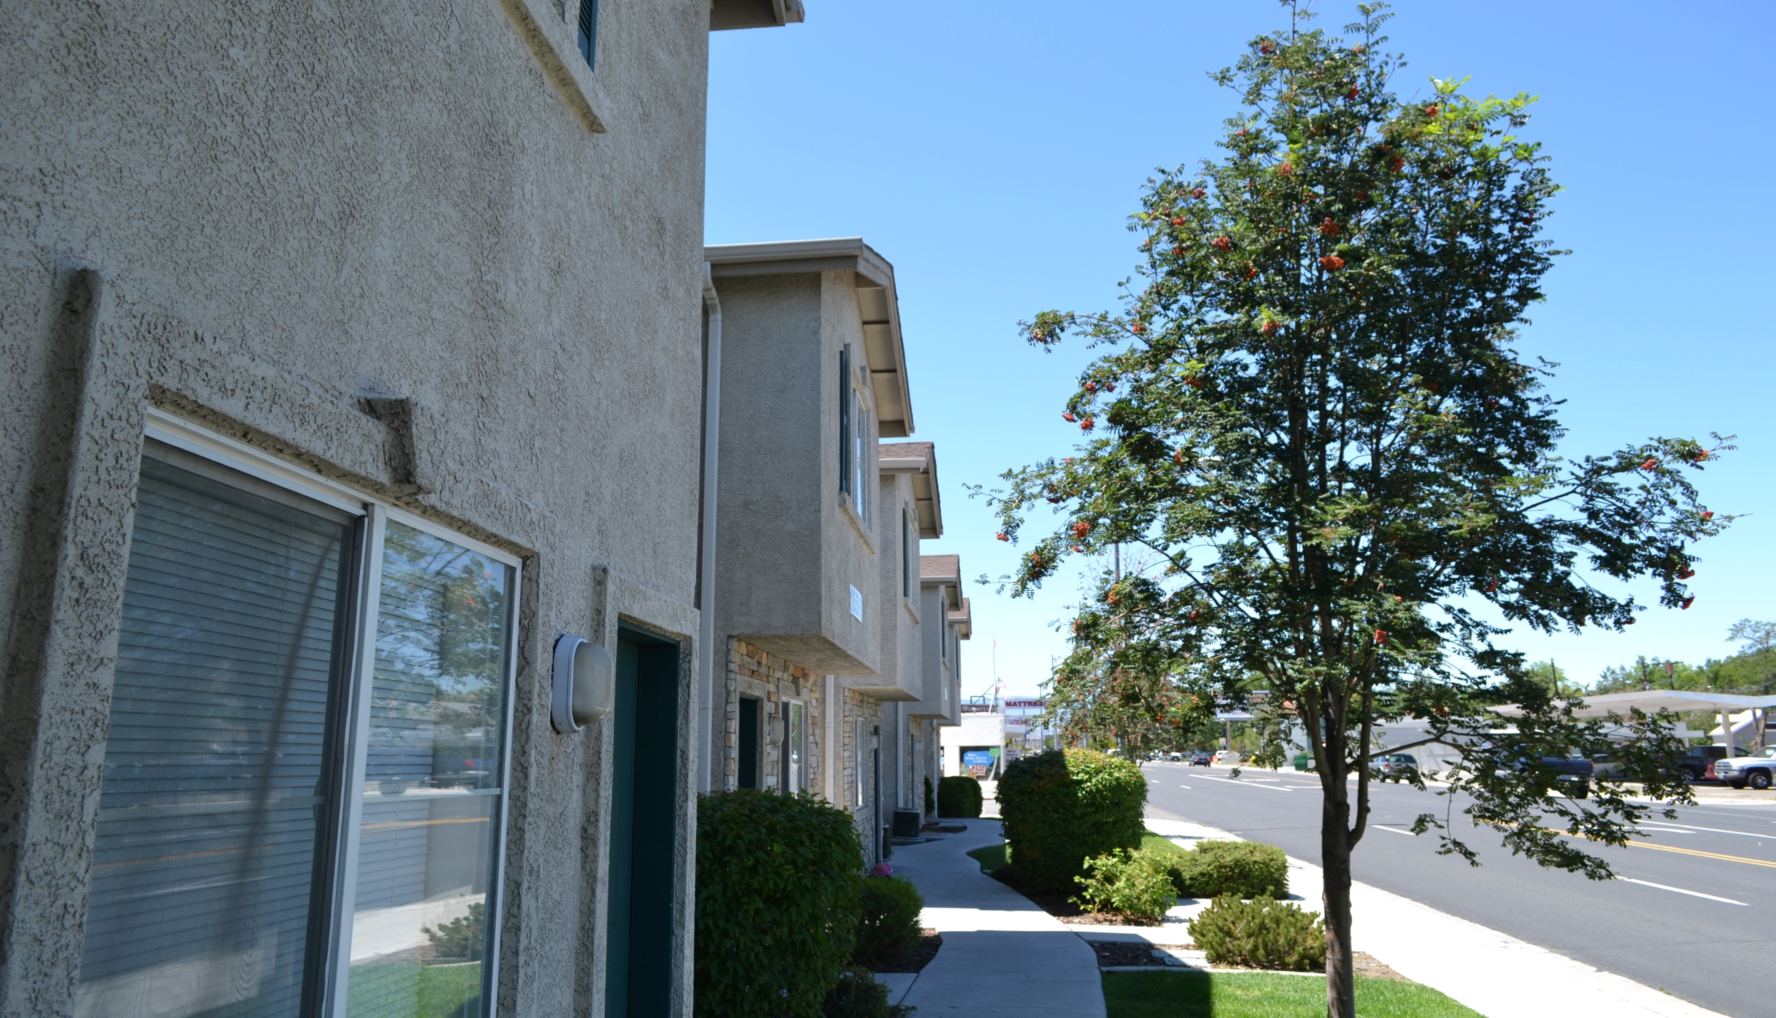
RHA

Slide 11
RHA
Quasi-Government Agency

Slide 12
RHA
Quasi-Government Agency
Board Governed

Slide 13
RHA
Quasi-Government Agency
Board Governed
Jurisdiction: Reno, Sparks, Washoe County

Slide 14
Community Partnerships
Multiply resources
Provide new clients for partners
Tenants receive services
Prevent duplication of services

Slide 15
Community Partners
Aging and Disability Resource
Center
Advocate for Elders for the
State of Nevada
Care Chest of Sierra Nevada
Casa de Vida
Community Services Agency
Department of Veterans
Affairs (VA)

Slide 16
Community Partners
Domestic Violence Resource
Center (formally CAAW)
Financial Guidance Center
Food Bank of Northern
Nevada
Job Opportunities In Nevada
Nevada JobConnect
Nevada Division of Welfare
Northern Nevada HOPES

Slide 17
Community Partners
Reno Police Department
Rotary Club of Reno
Safe Embrace
Sierra Nevada Job Corps Veterans Administration
Washoe County Health
Department
Other Local Nonprofit
Organizations

Slide 18
Public Housing
Mineral Manor

Slide 19
Market Rate
Housing
Prater Way Apartments

Slide 20
Housing Choice Vouchers

Slide 21
Housing Choice Vouchers
“Section 8” vouchers

Slide 22
Housing Choice Vouchers
“Section 8” vouchers
Pay a portion of monthly rent

Slide 23
Housing Choice Vouchers
“Section 8” vouchers
Pay a portion of monthly rent
Allow choice of location

Slide 24
Housing Choice Vouchers
“Section 8” vouchers
Pay a portion of monthly rent
Allow choice of location
RHA determines participant eligibility and must approve unit

Slide 25
Our Residents

Slide 26
Our Residents
Our families make less than 30% of the area median (average) income.

Slide 27
Our Residents
The median income for Washoe County is $73,500.
(family of four)

Slide 28
Our Residents
The median income for Washoe County is $73,500.
Our families have incomes less than $22,050.
(family of four)

Slide 29
Our Residents

Slide 30
Programs for Residents
Family Self-sufficiency programs

Slide 31
Programs for Residents
Family Self-sufficiency programs
Senior Services

Slide 32
Programs for Residents
Family Self-sufficiency programs
Senior Services
Youth programs

Slide 33
Affordable
and
Safe

Slide 34
Safe
Criminal Background Checks
All residents
No violent crimes
No sex crimes
No drug crimes

Slide 35
Success Stories
Autumn
Steven
Hannah
Shantrice

Slide 36
Success Stories
Steven Garcia
Family Self Sufficiency participant
High School Equivalency
Training at TMCC

Slide 37
Success Stories
Autumn Gitthens
Family Self Sufficiency participant
Paying full rent
Saved $16,409 in escrow

Slide 38
Neighborhood Stabilization Program

Slide 39
Neighborhood Stabilization Program
$22 million economic infusion during the recession

Slide 40
Neighborhood Stabilization Program
Cleaned up nuisance properties

Slide 41
Neighborhood Stabilization Program
Cleaned up nuisance properties
Revitalized neighborhoods

Slide 42
Neighborhood Stabilization Program
Cleaned up nuisance properties
Revitalized neighborhoods
Added 165 houses/duplexes to inventory

Slide 43
Top Performing Agency
Based upon
Properties
Finances
Management

Slide 44
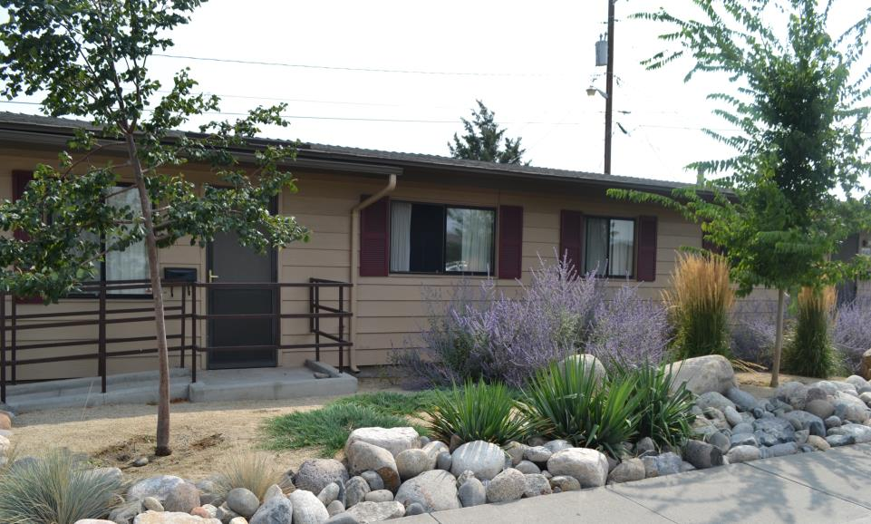
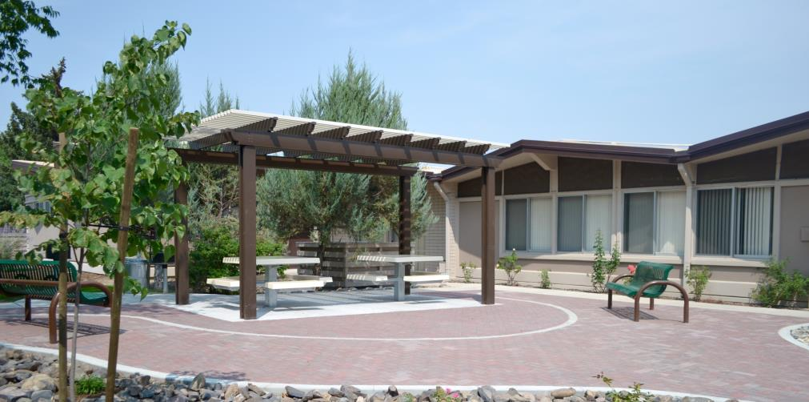
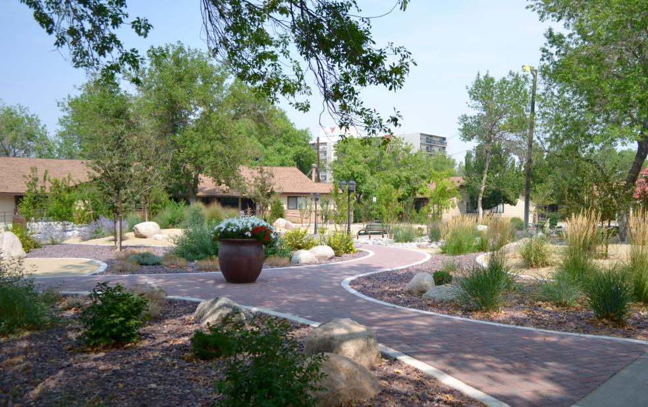
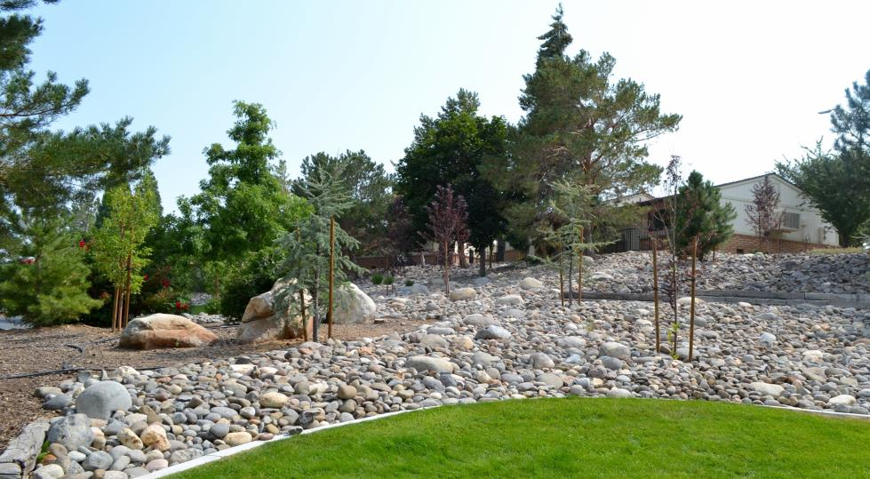

Slide 45
Reno Housing Authority

Slide 46
Waiting Lists

Slide 47
The Line
You are
here

Slide 48
The Line
You are (still)
here

Slide 49
Federal Funding

Slide 50
Federal Funding
Forecast:
uncertain

Slide 51
Creative Solutions

Slide 52
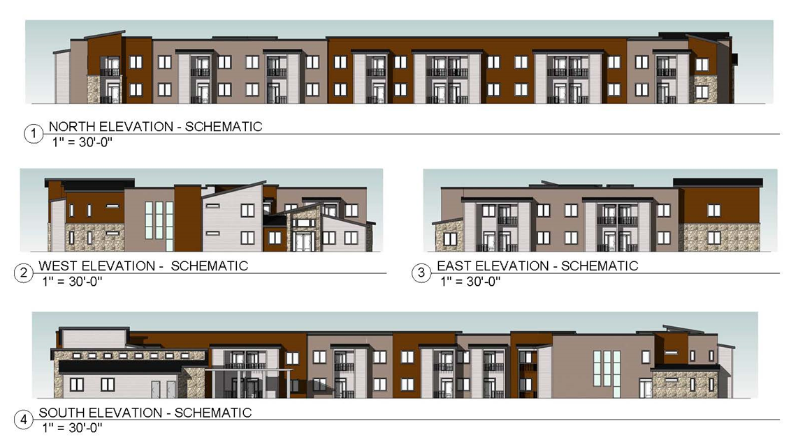
Sutro Street Senior Apartments

Slide 53
Creative Solutions

Slide 54
We’re All in this Together

Slide 55
75 Years of Service

Slide 56
Reno Housing Authority

Slide 57
Let’s make affordable
possible.
Reno Housing Authority

